Slide 1
Fahid Latheef A
DS-17
PROJECT 3
COMPLAINTS MANAGEMENT SYSTEM

Slide 2


Introduction
XXX company is a distribution logistics business unit and receiving complaints from its customers through various sources like call centre, mails, paper mode, each branch offices, retail offices, back
operation offices, etc.

Slide 3
Purpose
To set up an online web portal for Complaint Registration for costumer complaints of XXX logistics company such that this helps in
  Finding the root cause of the complaint and categorize the complaint to the respective category
  Set up a database for storing all the complaints
  This speed up the process of complaints resolution
  To set up an online web portal for Complaint Registration for costumer complaints of XXX logistics company such that this helps in in

Slide 4
Features
Online submission of complaints for the customers
Classify the complaints in different classes using a machine learning model which automates the classification of complaint part
Notify the admins about the complaints
Storing the complaint data in SQL database
Generate an Customer-ID
Customer can track and dispute the complaint

Slide 5
Solution Approach
Creating the ML model for classification of complaints and department for the complaint
Implement the web app in which the user can register the complaint and the complaint is rerouted to the correct department
The registered complaint is added to the database and an Complaint ID is generated
Created a Web Portal where the admin can resolve the complaints.
Create a web portal where the user can check for the status of their complaint
If the user disagrees with the resolution, he may dispute it.

Slide 6
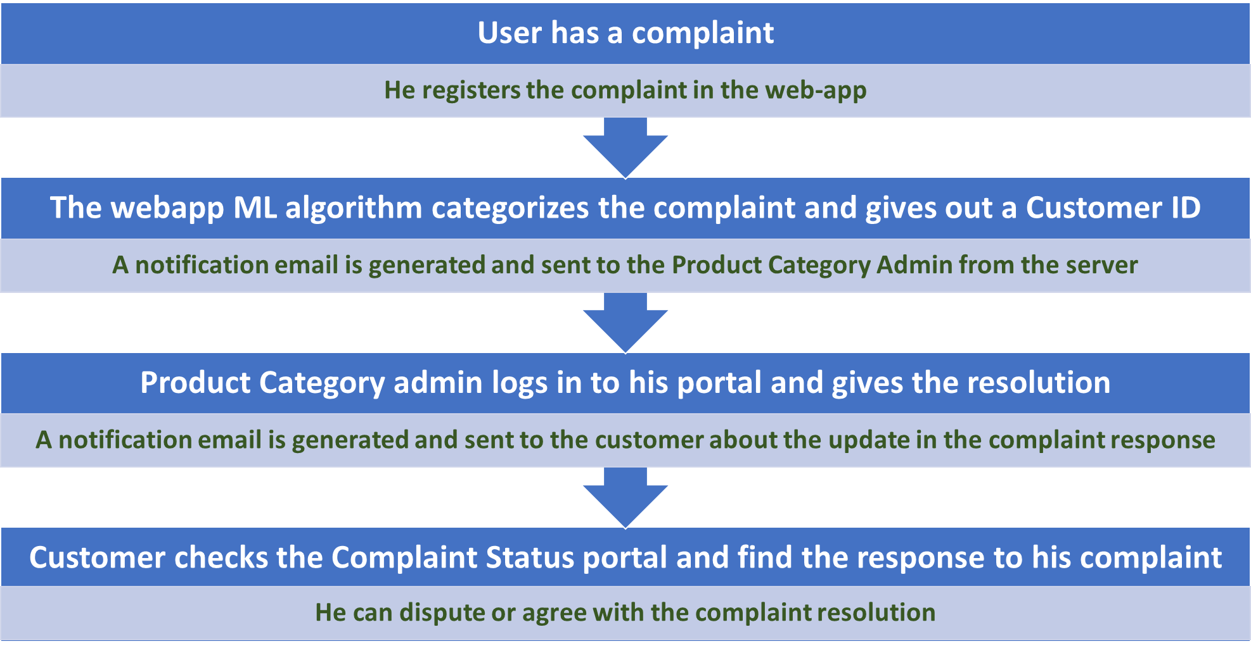
DATABASE IS UPDATED
DATABASE IS UPDATED
DATABASE IS UPDATED
DATABASE IS UPDATED

Slide 7
Benefits of the solution
Integration of complaints, dealers, back-office, employees etc.
Automatic classification of complaints which in-turn is useful to routing each complaints to its respective department
Automatic 24x7 system
Fast and streamlined
Cost cutting from the company point of view because of automation
User benefitted from the speed of the process

